Slide 1
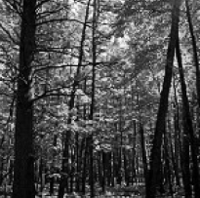
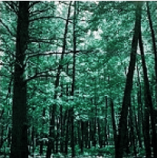
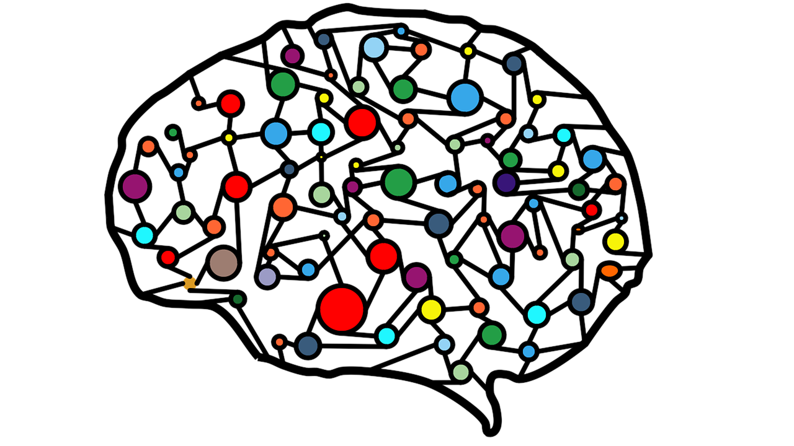
CMPE 258 - Deep Learning
Dr. Harry Li
Colorizing Grayscale Image
Team Members:
Moxank Patel
Meet Patel
Pratik Shah
Swapnil Wagh

Slide 2
Introduction
Image Colorization
Scribble Based Method
Simple Deep Neural Network with CNN
GAN
Kaggle Dataset - Landscape color and grayscale images
Number of Image: 7100
Dimensions: 150 * 150
https://www.kaggle.com/datasets/theblackmamba31/landscape-image-colorization

Slide 3
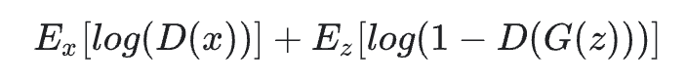
Generative Adversarial Networks (GAN)
Generator: Here its task is to generate real like data
Discriminator: Here its task is to differentiate between real and fake data
Loss Function: We are using Min Max Loss function and Mean Absolute Difference
For generator specifically we are adding Mean Absolute Difference, that resulted improvement in the quality of image generated.

Slide 4
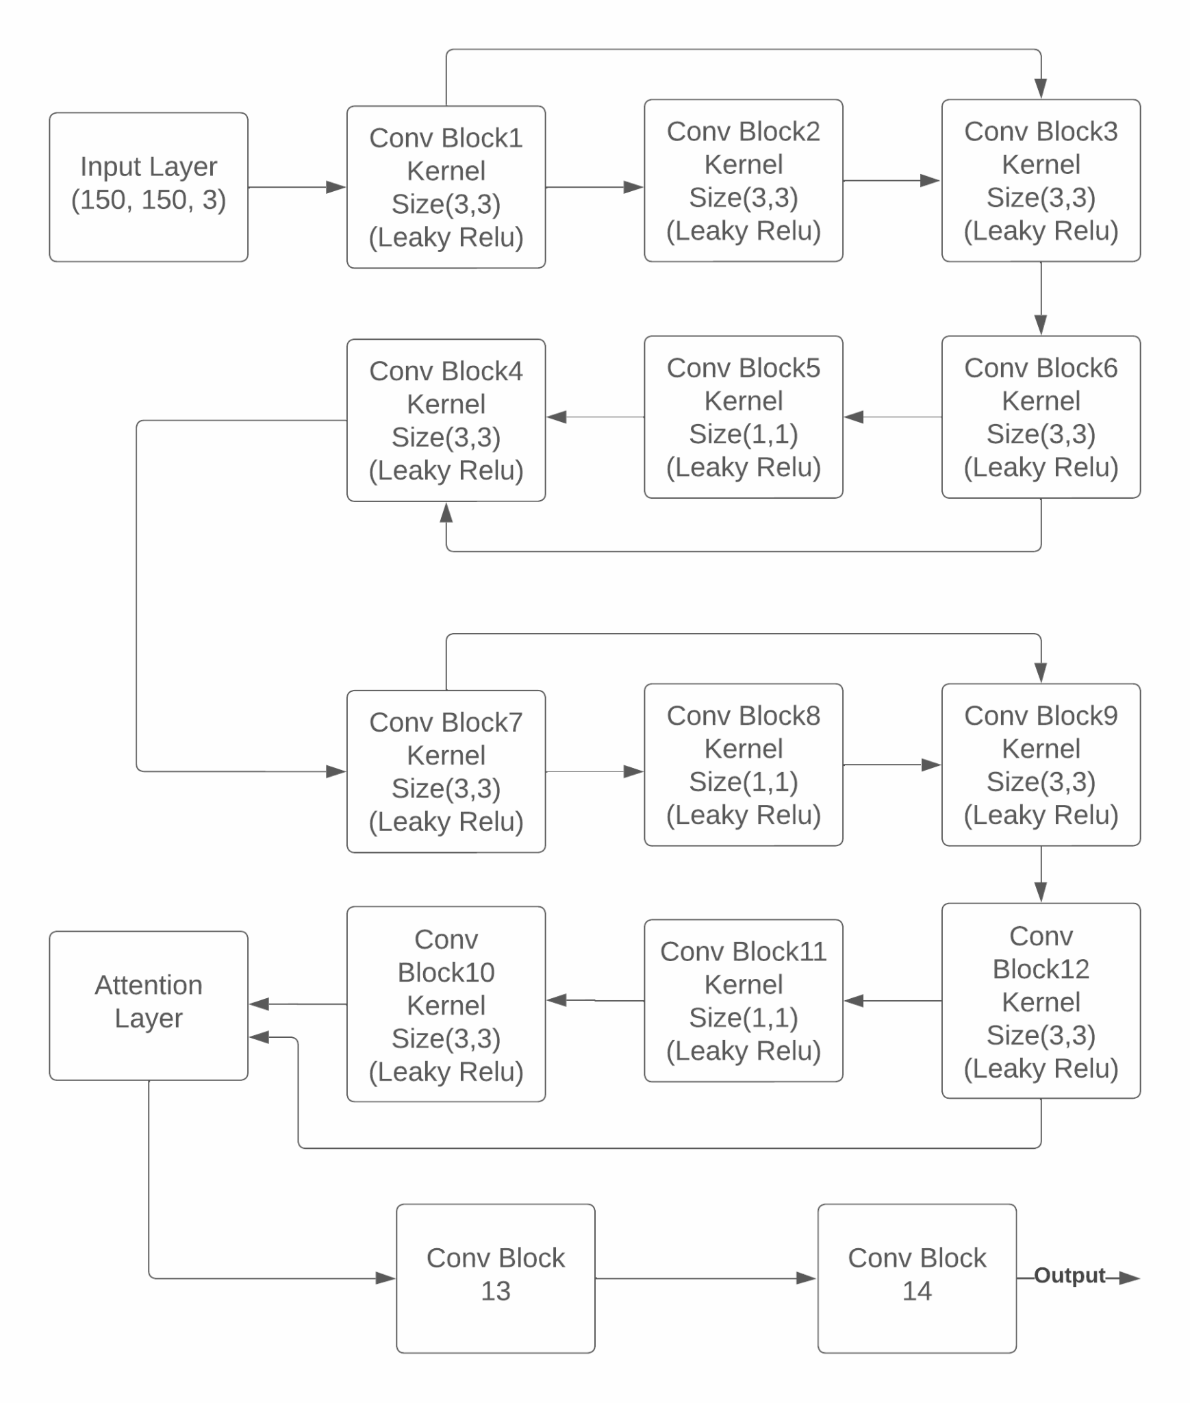
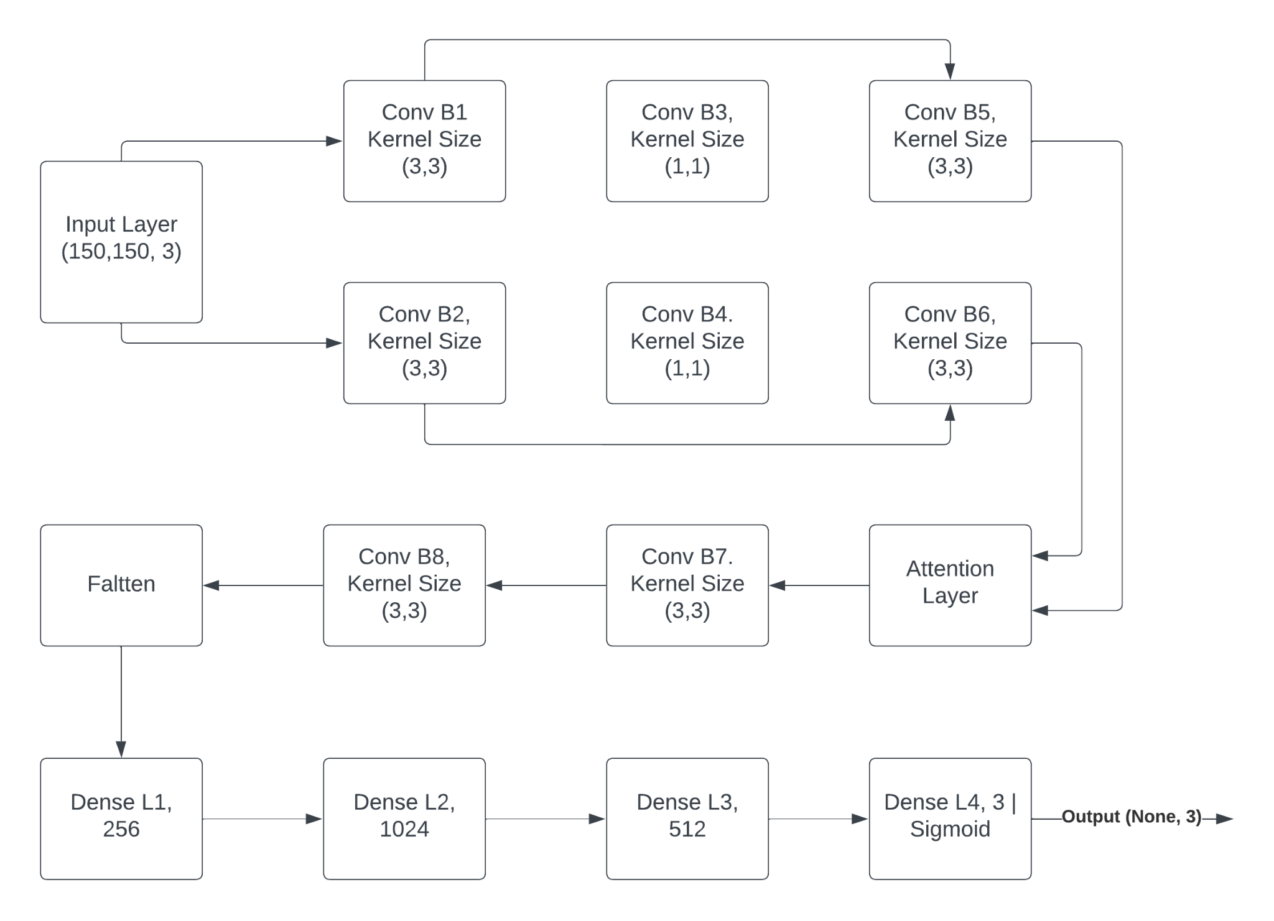
Architecture - Block Diagram
Fig 1. Generator Block
Fig 2. Discriminator Block
Total Parameters: ~4M

Slide 5
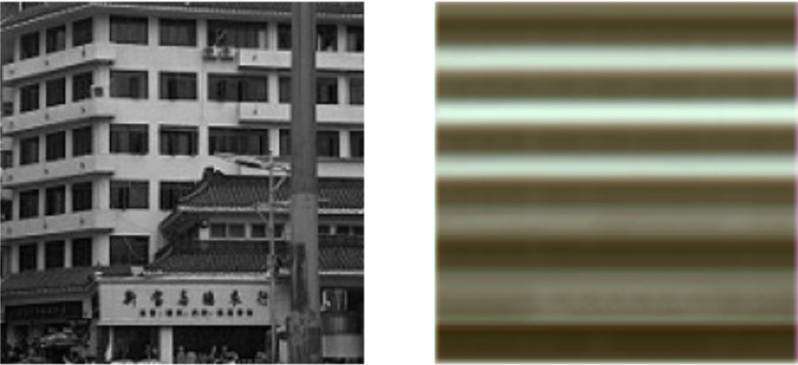
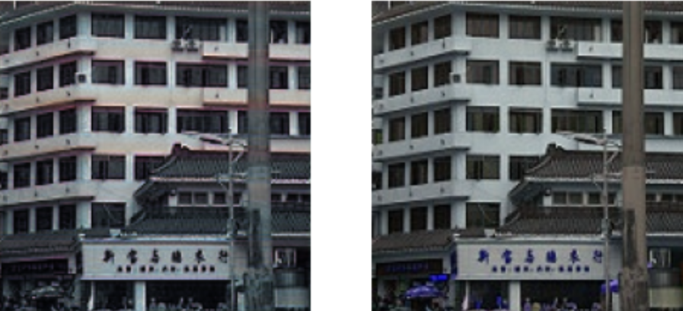
Inference on Training
Fig 3. Image 1. Original Grayscale Image
Image 2. Image generated by model after 1 epochs
Image 3. Image generated by model after 20 epochs
Image 4. Original Colored Image
Note: Numbering starts from left to right (1 to 4)

Slide 6
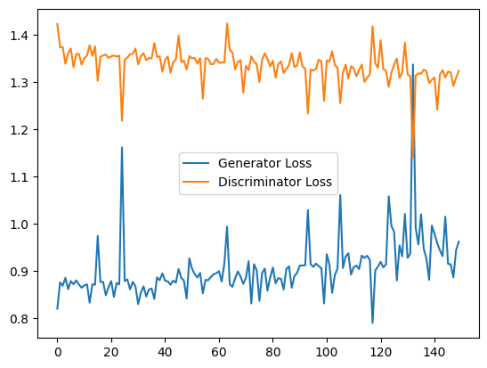
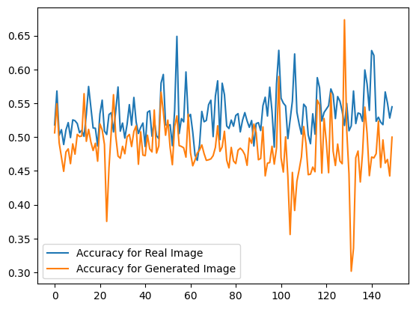
Results - Metrics
Fig 4. Loss per epoch
X Axis: # Epoch
Y Axis: Loss
Fig 5. Accuracy per epoch
X Axis: # Epoch
Y Axis: Accuracy

Slide 7
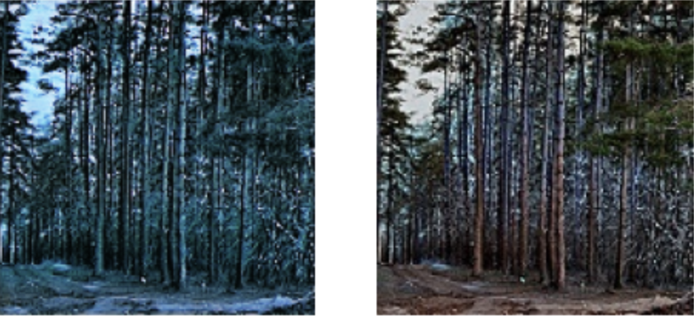
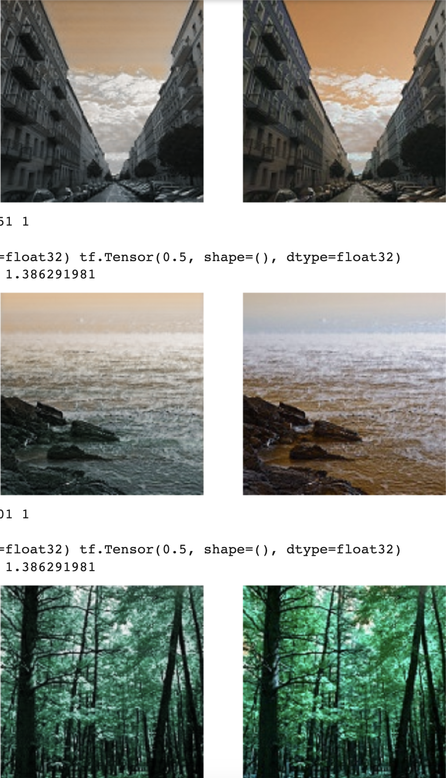
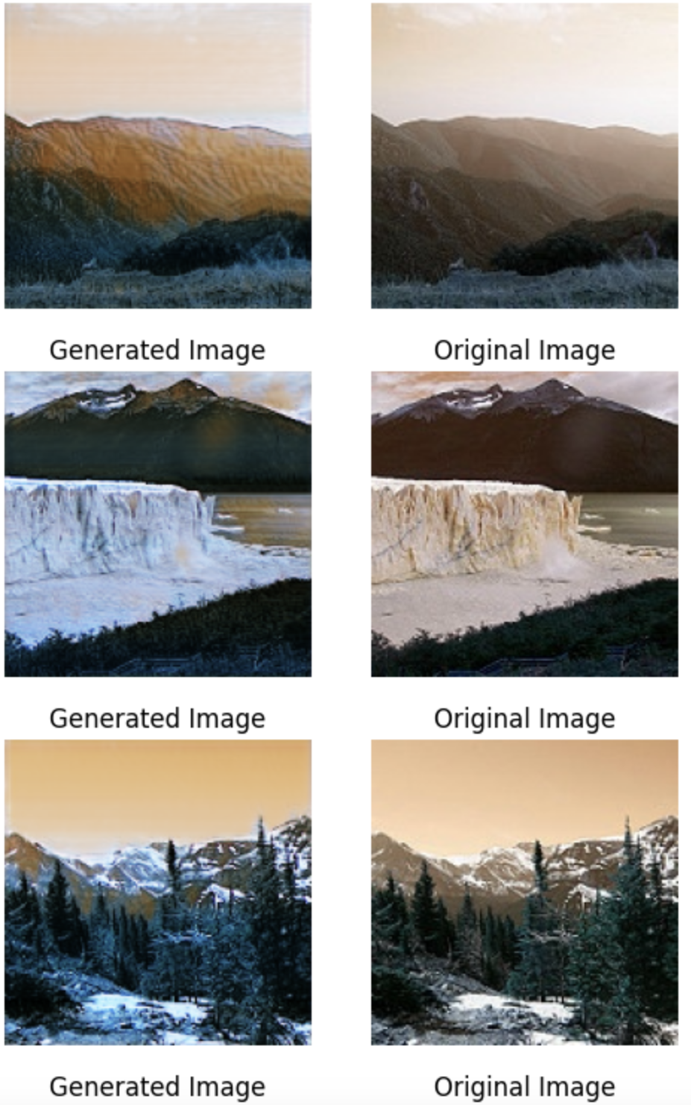
Results - Test Data
Fig 6. Left (Generated Images), Right (Original Colored Images)
On Test Data
Generator Cross Entropy Loss: 0.76781535 Generator Mean Absolute Error: 0.15612416
Discriminator Loss: 1.39312020

Slide 8
References
[1]. B. Li and Y. He, "An Improved ResNet Based on the Adjustable Shortcut Connections," in IEEE Access, vol. 6, pp. 18967-18974, 2018, doi: 10.1109/ACCESS.2018.2814605.
[2]. F. Marra, D. Gragnaniello, D. Cozzolino and L. Verdoliva, "Detection of GAN-Generated Fake Images over Social Networks," 2018 IEEE Conference on Multimedia Information Processing and Retrieval (MIPR), Miami, FL, USA, 2018, pp. 384-389, doi: 10.1109/MIPR.2018.00084.
[3]. Subakan, C., Ravanelli, M., Cornell, S., Bronzi, M., & Zhong, J. (2021). Attention Is All You Need In Speech Separation. ICASSP 2021 - 2021 IEEE International Conference on Acoustics, Speech and Signal Processing (ICASSP), 2021-, 21–25. https://doi.org/10.1109/ICASSP39728.2021.9413901
[4]. https://www.kaggle.com/datasets/theblackmamba31/landscape-image-colorization

Slide 9
Thank you.

